Slide 1
SQL Server 200 Replication
Lecturer: Ngo Huy Bien
Software Engineering Department
Faculty of Information Technology
VNUHCM - University of Science
Ho Chi Minh City, Vietnam
nhbien@fit.hcmus.edu.vn

Slide 2

Objectives

Slide 3

References
Designing SQL Server 2000 Databases for .NET Enterprise Servers.

Slide 4
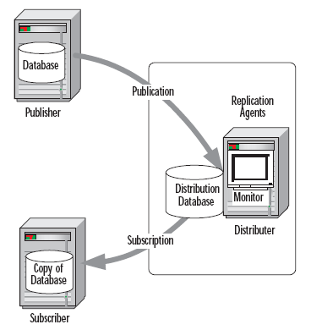
SQL Server Replication Architecture
The server that contains the actual database or databases to be replicated
is referred to as the Publisher.
The complete data set made available by the Publisher is called a publication.
A publication can contain any number of database objects such as tables, stored procedures, or views. It also might contain filtered data from tables. Each of these individual published items is referred to as an article.
Information about the replicated data is stored in a database on the Distributor.
The request for a publication to be sent to a Subscriber is called the subscription.
The recipient of a Publisher’s replicated data is called the Subscriber.

Slide 5
Replication Agents
Snapshot Agent
Distribution Agent
Merge Agent
Log Reader Agent
Queue Reader Agent
Miscellaneous Agents

Slide 6
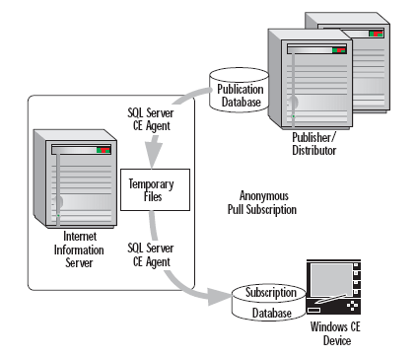
Transactional Replication
Transactional replication uses an initial snapshot of the data
applied to the Subscribers, then captures and propagates the individual transactions to Subscribers once data modifications have been made at the Publisher.

Slide 7
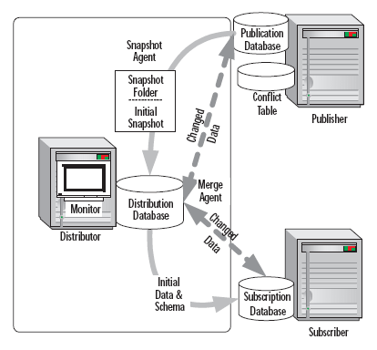
Merge Replication
Merge replication distributes data from Publisher to Subscribers while allowing both the Publisher and Subscribers to make updates to the data.

Slide 8
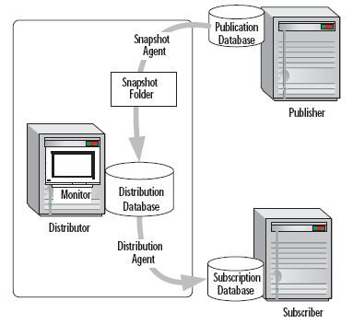
Snapshot Replication
Snapshot replication does not monitor updates to the data.
Rather, it distributes data exactly as they appear at a specific point in time.

Slide 9
Minimize Potential Conflicts
Use NOT FOR REPLICATION when creating IDENTITY columns. This tells SQL Server to use the existing value in the IDENTITY field from the publisher and not to assign a new one during replication.

Slide 10
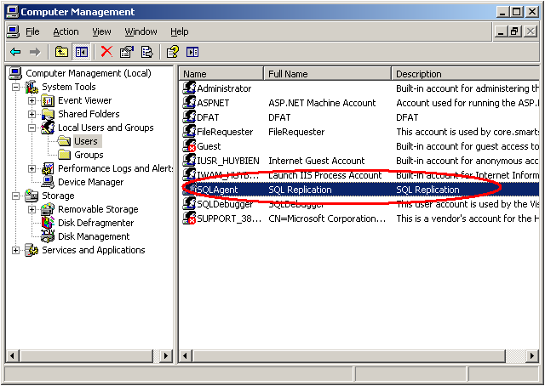
Creating SQLAgent User

Slide 11
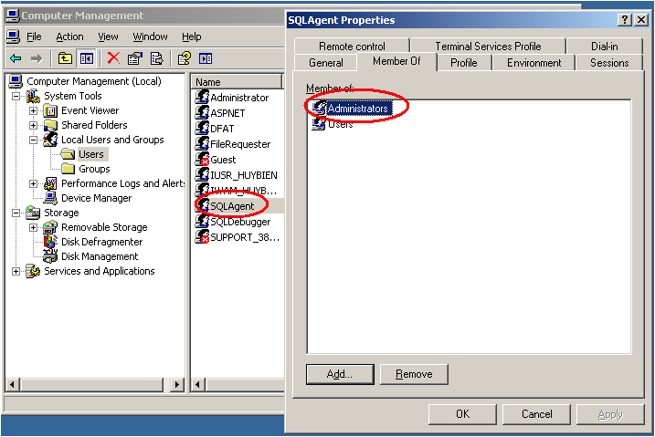
Adding SQLAgent To Adminstrators Group

Slide 12
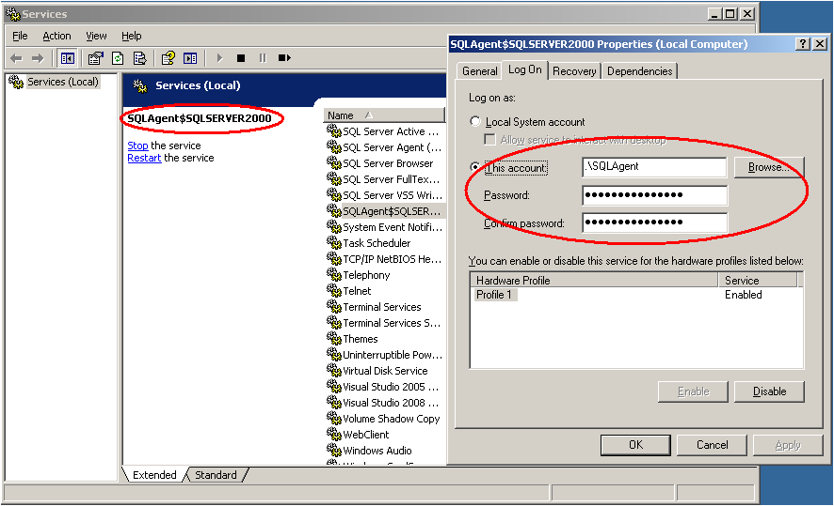
Configuring Log On User Of SQLAgent Service

Slide 13
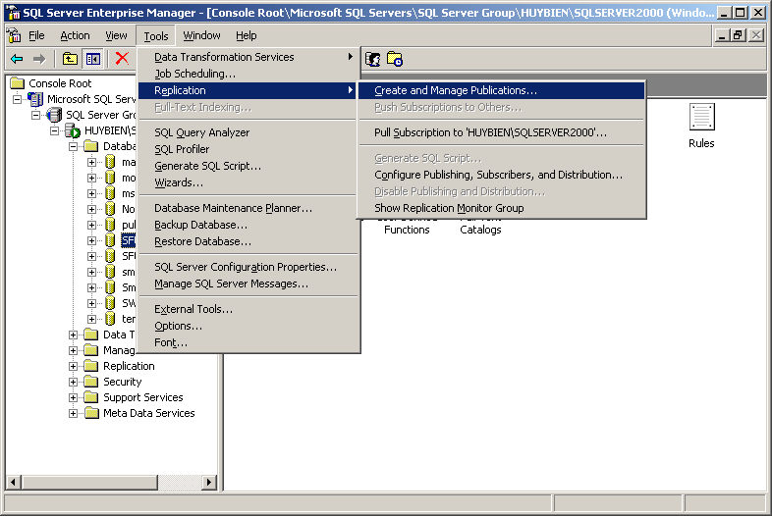
Configuring SQL Server Replication

Slide 14
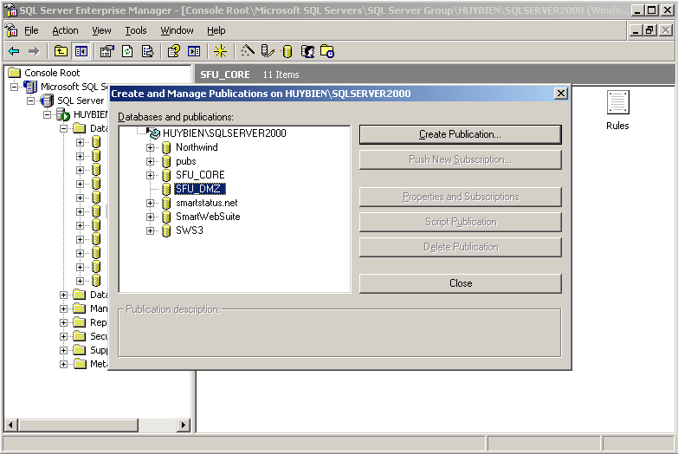
Configuring SQL Server Replication

Slide 15
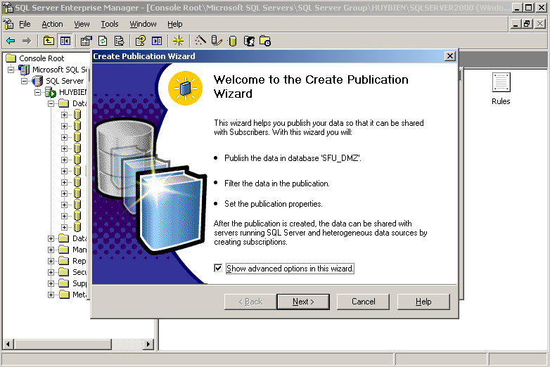
Configuring SQL Server Replication

Slide 16
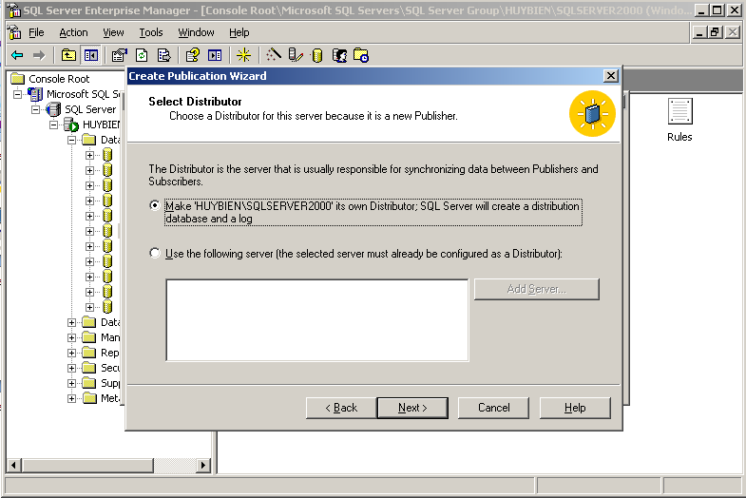
Configuring SQL Server Replication

Slide 17
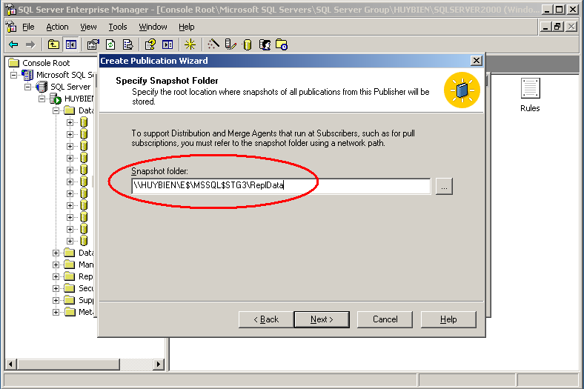
Configuring SQL Server Replication

Slide 18
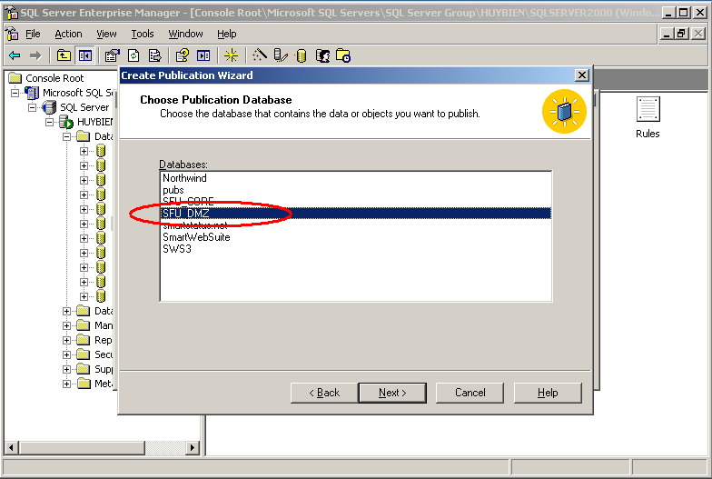
Configuring SQL Server Replication

Slide 19
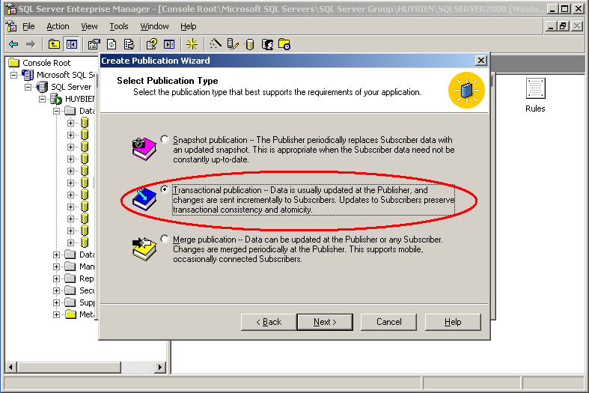
Configuring SQL Server Replication

Slide 20
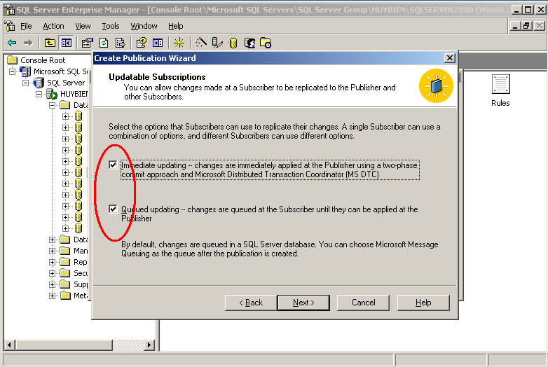
Configuring SQL Server Replication

Slide 21
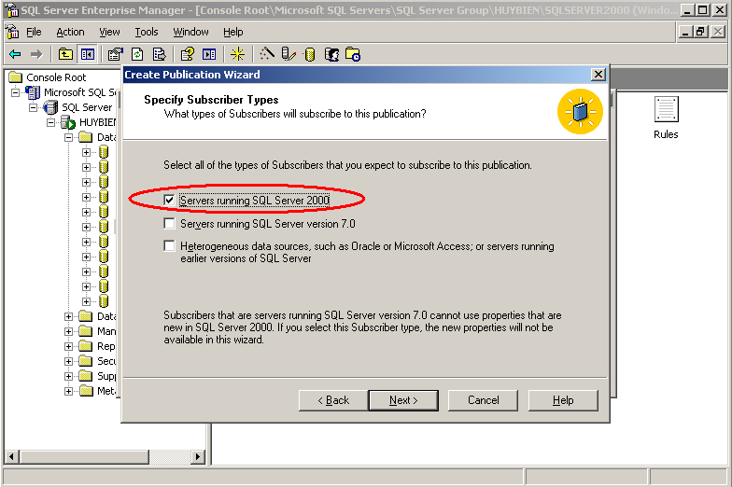
Configuring SQL Server Replication

Slide 22
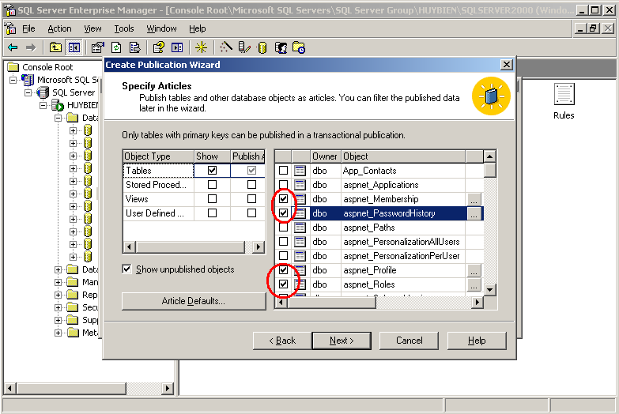
Configuring SQL Server Replication

Slide 23
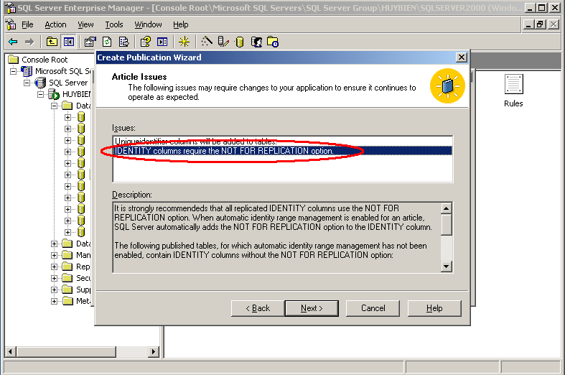
Configuring SQL Server Replication

Slide 24
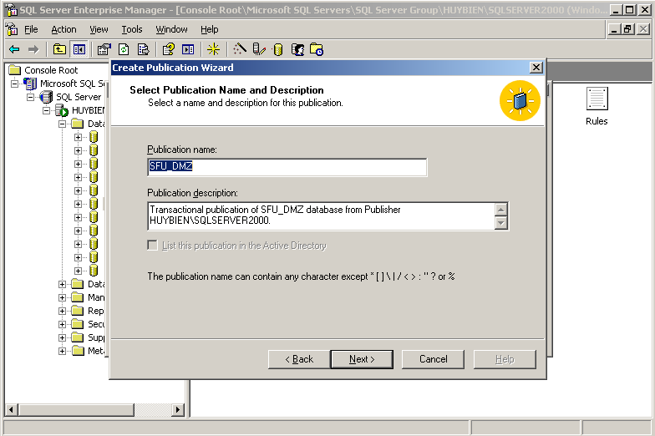
Configuring SQL Server Replication

Slide 25
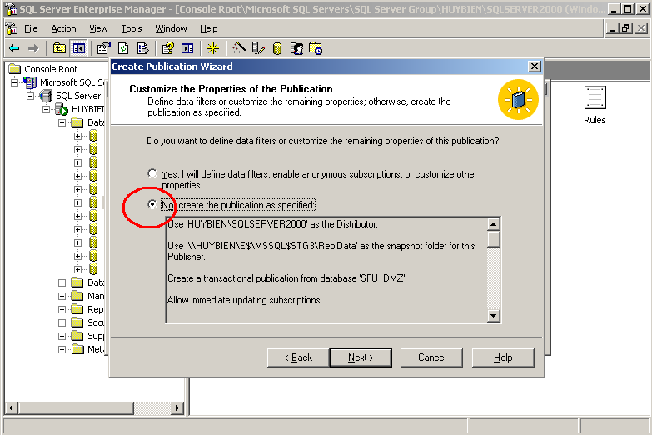
Configuring SQL Server Replication

Slide 26
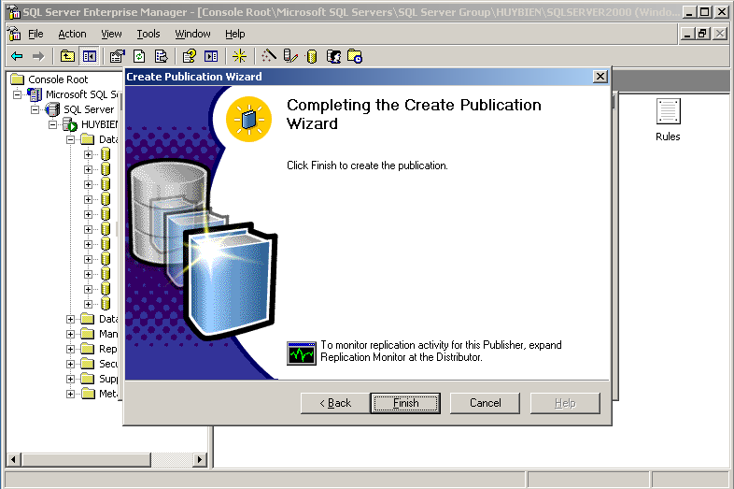
Configuring SQL Server Replication

Slide 27
T-SQL Encryption

Slide 28
Insert IDENTITY

Slide 29

Thank You & See You Again

